Slide 1
JavaFX
-Rohit Vaidya
JUG Hyderabad

Slide 2
JavaFX
JavaFX is a software platform for creating Rich Internet Applications that can run across variety of platforms[1]
Collection of Java Packages with ability to add fancy GUI’s to your Java application
Groovy and Scala can also be used to write JavaFX. JVM Languages indeed!!!
JavaFX is official standard part of Java platform

Slide 3
JavaFX - History
Formerly called F3 (Form Follows Function) and developed by Chris Oliver at Sun Microsystems
JavaFX was initially developed as a scripting language however it was discontinued by Oracle and declared dead in JavaOne (2010)[2]

Slide 4
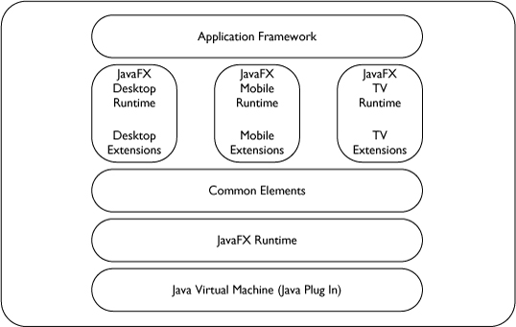
JavaFX Stack

Slide 5
Possibilities
CSS support
Visual effects – shadow, reflection, blur, perspective
Animation – cubes, cylinders, spheres etc
Charts
3D objects
Touch interface
Property bindings

Slide 6
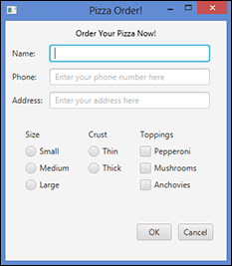
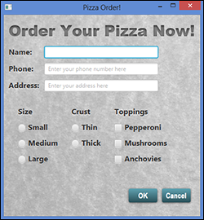
Possibilities

Slide 7
JavaFX - Lingo
Stage – Top level container for all JavaFX objects
Scene – A scene is a hierarchical node structures that contains all scene’s components
Group – Group is a general purpose container node

Slide 8
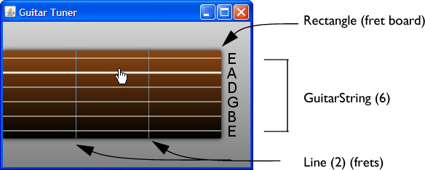
JavaFX - Lingo

Slide 9
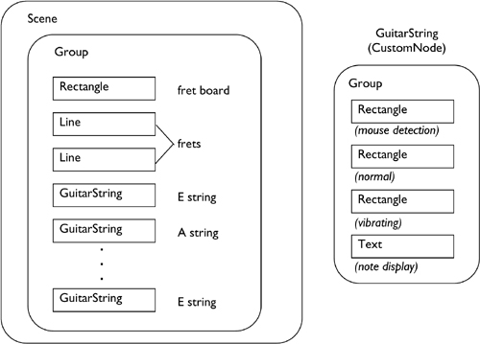
JavaFx Lingo

Slide 10
JavaFX Important Packages
javafx.application: Core package on which all JavaFX application depend
javafx.stage: Most important class here is the Stage class
javafx.scene: Most important class here is the scene class which is the container that holds all UI elements
javafx.scene.layout: Contains Layout Manager. Job of Layout manager is to determine position of each control displayed
Javafx.scene.control: Individual controls like buttons, text boxes and labels exist here

Slide 11
JavaFX LifeCycle
Application class is responsible for managing the lifecycle of JavaFX application
Lifecycle steps
Create an instance of Application
Call init method
Call start method
Wait for application to End
Call the stop method

Slide 12
JavaFX Lifecycle
init (): Default implementation of init does nothing.
One can override to perform any processing before application UI is displayed
start (): No default implementation and is declared abstract.
Your app must override this. Build and display the UI
Wait for application to End. Typically happens when user signals end of program
stop(): Default implementation does not do anything
One can override to to perform any necessary processing as program terminates.

Slide 13


JavaFX Launching Application
Standard entry point to Java program is the main method
The launch method is in Application class

Slide 14
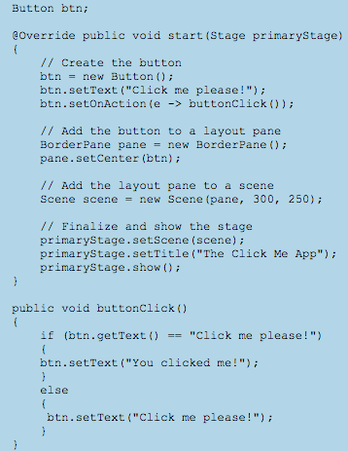

Slide 15
JavaFX - Layouts
Hbox – Provides a horizontal layout of its contents in a single row
Vbox – Provides a vertical layout of its content in a single column
Flow – Provides a layout of content in either horizontal or vertical flow wrapping at current height or boundary
Tile – Same as flow. But all cells are uniform size. Controlled via tileHeight and tileWidth

Slide 16
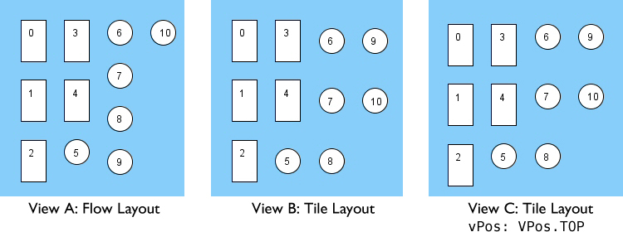
JavaFX - Layouts

Slide 17
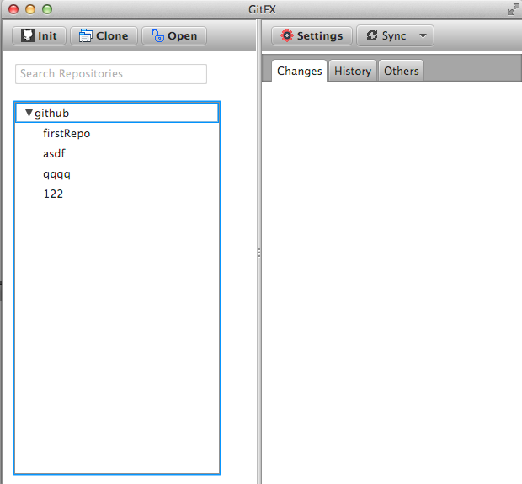
GitFX – Project

Slide 18
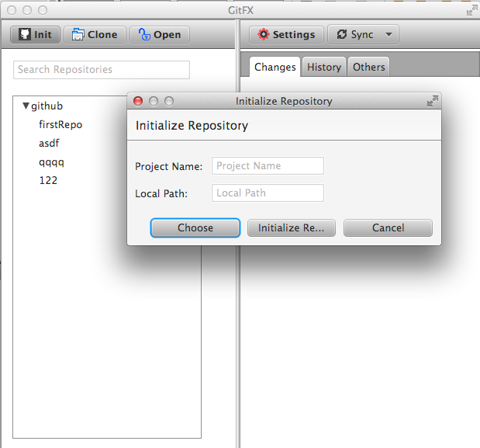
GitFX Project

Slide 19
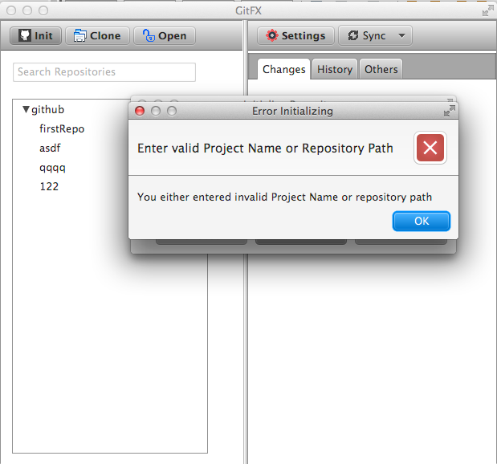
GitFX Project

Slide 20
JavaFX Deployments
Launch from command line using java launcher
Launch as a desktop application from a JAR or self contained application
View in a web page
Launch by clicking a link in the browser to download an application

Slide 21
References
1 http://en.wikipedia.org/wiki/JavaFX
2 http://java.dzone.com/articles/oracle-discontinue-javafx
3 JavaFX for Dummies
4 Effective JavaFX
Deployments: http://docs.oracle.com/javafx/2/get_started/basic_deployment.htm#BABFAFEC

